Slide 1

Presented by
Shri P K Biswas
General Manager (IT)
NHPC Limited
at
National workshop on CPPP, New Delhi.
January 21, 2019

Slide 2






NHPC LIMITED AT A GLANCE
Incorporated in 1975 with Authorized Share Capital of Rs. 200 Crs.
Accorded Mini Ratna Status in 2008
Paid Up Capital
Rs.10259 Crs
Net Worth
Rs. 28328 Crs
Capital Employed
Rs. 47822Crs
GoI Stake 73.64%,
Stock listed on NSE and BSE in 2009
Installed capacity
5551.2 MW
6947 Employees
Notes:
2

Slide 3



NHPC -TODAY
PROJECTS
UNDER S&I
Hydro – 2
PROJECTS
UNDER
CONSTRUCTION
Hydro - 2 (2800 MW)
+
Pakal Dul (1000 MW)***
POWER
STATIONS
Hydro-22 (6971.2MW)
+
Wind-1 (50 MW)
+
Solar-1 (50 MW)
PROJECTS UNDER
CLEARANCE
Hydro – 10 (7795MW)
RE – 2 (40 MW)
PROJECTS
UNDER
PRE S&I
Hydro – 3
780 MW
581 MW
7835 MW
2800 +1000 (JV)
= 3800 MW**
7071.2* MW
TOTAL = 20,067.2 MW
* Including JV (1520 MW: Indri Sagar- 1000 MW , Omkareshwar- 520 MW))
** Including JV(1000 MW of Pakal Dul HE Project) .
Note: NHPC has also added 1006.2 kWp rooftop grid connected solar power plants.

Slide 4
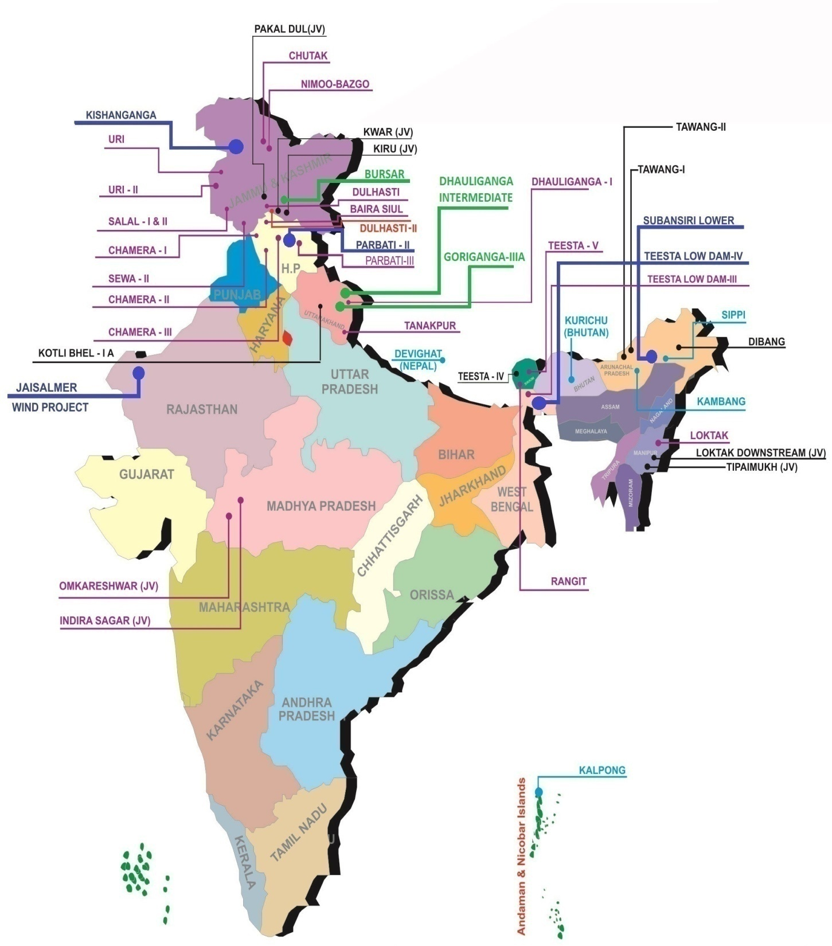


POWER MAP OF NHPC
22 POWER STATIONS
HYDRO – 21
WIND – 01
03 HYDROPROJECTS UNDER CONSTRUCTION
PROJECTS UNDER
CLEARANCE/ CONSIDERATION
10 HYDRO
1 THERMAL
3 RE
06 PROJECTS UNDER S&I
05 PROJECTS COMPLETED
DEPOSIT/TURNKEY BASIS

Slide 5
E-Procurement History in NHPC
SN | e-procurement Service Hired from | Effective date |  |  | Nos. of Tenders published
 |  | From | To | Duration
1. | M/s Mjunction Services Limited (A joint venture of SAIL & Tata Steel) | Dec-08 | Jun-12 | 3½ Years | 28
2. | Telecommunications Consultants India Ltd. - TCIL (A. Govt. of India Enterprises) | Jul-12 | Dec-13 | 18 months | 995
3. | M/s MSTC Limited, Kolkata, A. (Govt. of Enterprises) | Jan-14 | Sept-15 | 21 months | 1500
4. | Govt. e-Proc. System of National Informatics Centre (GePNIC). | Oct-15 | Till Dec-18 | 3 Years+ | 7656 (Approx. 2500 tenders per year)

Slide 6
NHPC e-Proc. Statistics on GePNIC
SN | Description | Value
1. | No. of NHPC Tendering Location including NHPC Corporate office, Faridabad | 42
2. | Top Ten NHPC locations from where maximum numbers of tenders are performed on GePNIC portal. | Teesta-V Power Station (Sikkim) Salal Power Station (J&K) Dulhasti Power Station (J&K) Chamera Power Station (HP) Tanakpur Power Station (UK) Loktak power station (Manipur) Dhauliganga Power Station(UK) Teesta Low Dam Project Stage IV (WB) Chamera-II Power Station (HP) Teesta Low Dam III Power Station (WB)
3. | No. of NHPC users on GePNIC (All locations) | 1000 plus
4. | Training provided to NHPC officials & bidders with support of NIC (FMP). | Around 50 days at various locations of NHPC. (Sikkim, Manipur, J&K, UK, HP and NHPC CO, Faridabad & others.)
5. | Support Service Teams for NHPC Officials and Bidders. | FMP-NICSI (2 Nos.) NHPC CO e-proc. Team 24 x7 NIC Helpdesk

Slide 7
NHPC e-Proc. Statistics on GePNIC

Slide 8
NHPC High Value Tenders on GePNIC
SN | Description | Value / status
1. | Lot-1 Civil Works Package of Teesta HE Project Stage-IV, Sikkim: | Estimated cost: 1671.36 Crore Numbers of bidders- 3 Nos. Tender in Evaluation Process Numbers of items in BoQ – 504
2. | Lot-2 Civil Works Package of Teesta HE Project, Stage-IV, Sikkim. | Estimated cost: 1198.00 Crore Numbers of bidders- 4 Nos. Tender in Evaluation Process Numbers of line in BoQ – 465
3. | EPC Contract for development of 50 MW capacity Solar Power Plant- Tamil Nadu. | Numbers of bidders- 4 Nos. Process completed in June 2017 Numbers of items in BoQ – 60 Tender AOC @ Rs.288 cr.
4. | EPC Contract For 10 MW Capacity Floating Solar Power Project at West Kallada, Kollam District, in the State of Kerala. | Numbers of bidders- 5 Nos. Process completed in Dec 2018 Tender at Award Stage@ Rs.60 cr.
5. | Subansiri Lower Project, North Lakhimpur on the border of Aruncachal Pradesh and Assam. Work-Protection work of Heading excavation and Rock Support of Surge Tunnel ST-5 to ST-8 | Numbers of bidder- 1 No. Process completed in Sept 2018 Tender at Award Stage@ Rs.24 cr.

Slide 9
NHPC Perspective on GePNIC
The GePNIC solution is generic in nature so adopted by NHPC for all kinds of procurement needs such as Goods, Services and Works.
Enhanced Transparency, Adhering to Guidelines of Central Vigilance Commission, IT Acts and GFR resulting less Legal Issues relating to tenders and further award processing.
Strong in-built security features including two factor authentication with DSC as per IT Act.
Large Accessibility, efficient & transparent process, Secured encryption & decryption of bids resulting reduced procurement time.
Massive infrastructure for support and trainings program are being provided for Tendering officials and bidders.

Slide 10
Benefits to bidders
No registration charges & participation fee from bidders.
Availability of complete tender information / status to bidders performed by buyer on 24x7 basis.
Facility of digitally signing of bid documents and submission online thereafter.
Provision to modify the bid documents any time till closing of bid submission.
Being fair and transparent system inspires confidence among the bidder promotes vide participation.
As GePNIC is already implemented in various Government Departments, Organizations and States hence bidders are comfortable while participating in Tenders.

Slide 11
Future Plan for Procurement Related Services in NHPC
NHPC desires to continue GePNIC Services in future also and expect continuous and same quality support from NIC.
NHPC is also considering to increase the scope of work i.e. to bring all procurement related activities including e-Reverse auction (e-RA), e-Auction for disposal of Assets under one umbrella. For this NHPC advises NIC to facilitate all concerned departments with some options in application package so that buyer procurement policies can be accommodated.
Integration with present NHPC - ERP system in order to avoid repeated identical work preformed during award of contracts/works.

Slide 12
NHPC Concerns
Aadhaar / OTP based login Authentication.
Use of ‘up-to three’ Multi Currency in single high value tenders.
Implementation of Payment Gateway for submission of EMD / Tender fee resulting no manual intervention.
Identification of online bid and off-line documents (EMD / tender fee) submitted by bidders.
As in special case, system should allow to change tender opening committee members at the time of opening of tender due to non-availability / transfer of tendering officers.

Slide 13
Thank you

