Slide 1
JNPT's experience with the E-procurement portal
21st January 2019

Slide 2
e-Procurement – NIC Services for increasing Transparency
The factors driving the adoption of e-Procuremnt are:
  Reduced purchasing cost and improved efficiency
  Standardized purchasing processes across the organization
  Reduced administrative costs with better effectiveness
  Significant reduction in the procurement cycle
  Reduced discretion
At the same time the inhibitors to adoption are:
  Lack of supplier readiness
  System integration issues (compatibility and interoperability)
  Confidence on the system (Security, Functionality and Performance)
  Insufficient skilled staff
e-Procurement involves a set of technology solution which concentrate on different key areas of procurement such as
  e‐Tendering,
  e‐Auction or Reverse Auction,
  e‐Catalogue/Purchasing,
  E-Market Place,
  e‐Invocing etc.,.

Slide 3
Jawaharlal Nehru Port Trust (JNPT) is the biggest container handling Port in India, handling around 55% of total container handled by all Major Ports in India. In its coveted role as the Hub Port on the Western Coast of India, JNP is ranked among top 35 Container Ports in the World
650+ tenders worth Rs 3700 Cr executed at JNPT through online tendering
E-procurement implemented for all tenders of JNPT
# Tenders
600
35.1
400
41.7
Goods
Services
200
Works
23.2
87
0
2015-16
2016-17
2017-18
2018-19
Total
Procurement process at JNPT is completely online, paperless and transparent
Note: FY 2018-19 data is till Dec '18
Source: Govt. of India

Slide 4
JNPT's experience with e-procurement portal has been excellent till date
Multiple benefits of e-procurement seen in JNPT
Positive feedback received from bidders on the e-procurement process
1
Completely paperless process
  Only soft copies of documents are required; hard copies required for EMD & bid fee only
Higher savings/ revenue through e-auctions
  E-auctions help realize the true market value (H1/L1) of a tender
  All land allotment tenders of JNPT SEZ are based on e-auctions
Reduced tender execution time
  Due to soft copies of documents, evaluation process is expedited & TAT is reduced
Effort reduction due to easy record keeping
  Soft copies help in easy record keeping
Online bid submissions on the e-procure portal is a very good step towards increasing the transparency of the tender process
2
Bid submission process is very simple and hassle-free; document checklist feature helps ensure that the bid submitted is correct
As all tender related communication/ documents are available at one location, bid preparation becomes easiers
3
Multiple security checks (eg – digital signature, passwords etc.) in the e-tendering process provides comfort that the bid is secure
4

Slide 5
JNPT E-tender cum e-auction process followed for JNPT SEZ land allotment on lease (forward auction)
The Port land policy guidelines mandates that all port land needs to be allocated on lease basis through a tender-cum-auction process. JNPT followed tender-cum-auction for allocating land earmarked for setting up a Special Economic Zone (SEZ) at JNPT.
The process adopted has 2 stage of tender process followed by e-auction process (forward auction, as maximum price of plot is to secure).
Thus, bidders are subject to technical qualification and the financial bids of the successful technical bidders are opened and the highest bid received is used as the starting rate for auction of said plot.
The highest bidder in the e-auction process is the successful bidder for the respective plot.
User department can select to mask the names of the bidder during the e-auction process and the names of the bidders quoting the rates cant be seen by any of the bidder and also the user dept to maintain the secrecy of identity, thus the secured transparent process of auction is ensured.
User department can select to decide the increment value (in % or absolute value) for the quote to avoid irritating/ auction rigging quote increments and serious bidders only quote
The maximum limit of forward quote is also provided to ensure no rigging of auction quote occurs
The auto extension of process happens if bids are received in the threshold limit of auction closing and the extension duration of 10 mnts is provided to ensure equal opportunity for all bidders, further in extended period if any bidder puts his increment quote after 5 minutes then only the auto extension time is granted and the active bidders must be alert to take note of it
The auction process of JNPT have given us an opportunity to learn and improve during 3 auction process carried out till date and few more will be taken up in near future

Slide 6
JNPT SEZ's experience with e-tender cum auction process has been excellent till date
Bidders acceptance for the e-tender cum e-auction process (Which all of them have used first time )
JNPT SEZ process of land allotment : JNPT is in the process of allotment of 277 HA of its free hold land on lease for 60 years and to make the process transparent and hassle free the CPP’s e-procurement portal’s e-tender cum e-auction module is being used by JNPT-SEZ (Forward auction process to ensure that the maximum price for the land is quoted by bid participants)
On registration by any bidder for said tender, all automated communications pertaining to said tender are received. Secured online process with easy steps helped bidders to upload bid documents efficiently
After the technical and financial evaluation the reserve price discovered is the base price for the e-auction process to commence and bidder is able to participate online with his team with cool mind.
The said process was followed for 3 tender cum auction process till date by JNPT-SEZ and have been successful in all respect where by around 75 acres of land out of 440 acres of land to be allotted on lease is allotted.
The auction process with auto increment facility to ensure equal opportunity for all bidders have enhanced the confidence of the bidders about the transparent system and have emerged good participation from MNC’s. This has resulted a good rate for the JNPT SEZ land
JNPT SEZ with the help of this system able to get 6.5 times higher rate than the reserve price for one of the plot where MNC bidders participated in e-tender cum e-auction process

Slide 7
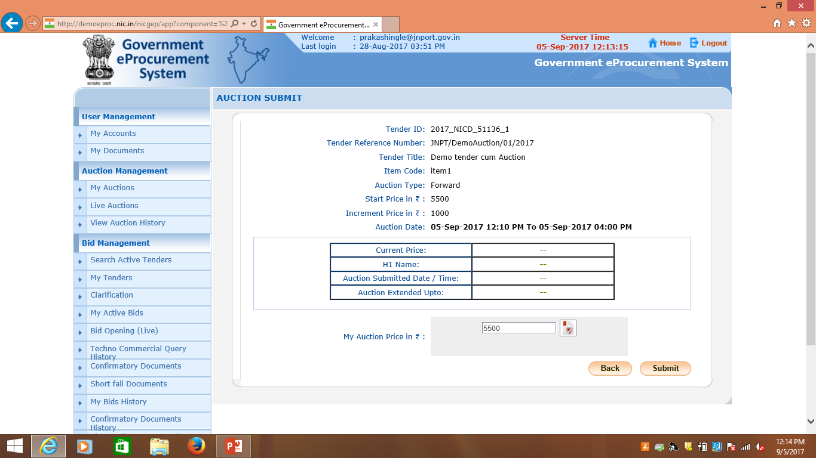
This slide is used by bidder to enter his bid price which provides all related data transparently for the bidder to take call for his bid price with cool mind
2.. Click on Submit
1..Enter your Auction price and sign it

Slide 8
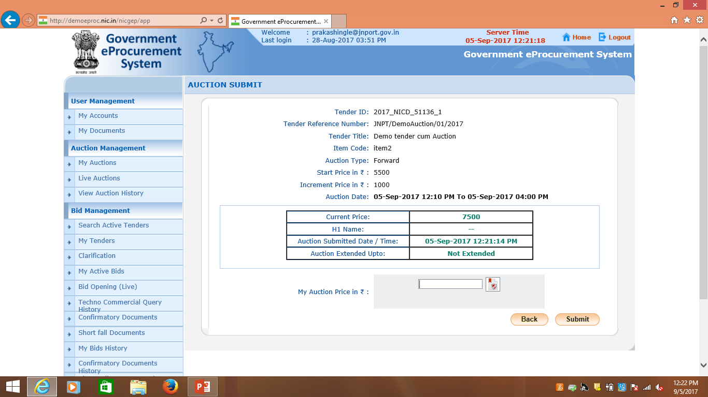
In case of auto extension, the data of the extended time is shown so that the bidder can execute his bid quote and also the changes are real time so that there is no lapse so that the bidder is rest assured of his bid execution in time with cool mind

Slide 9
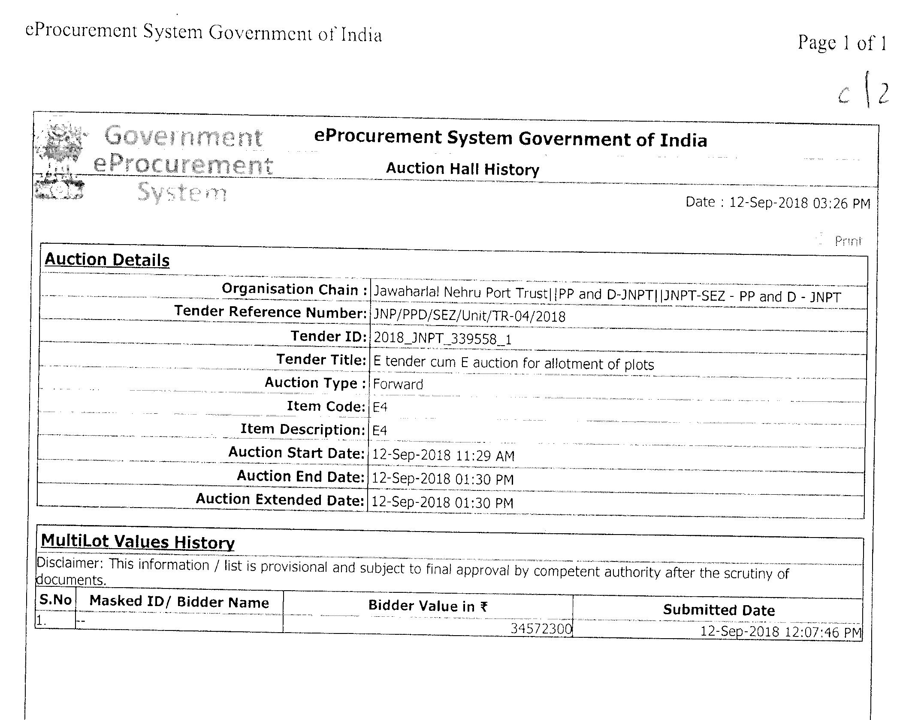
The slide show the multi lot auction value history where the value of auction quoted are displayed for a particular plot and based on the final time of the auction the successful bidder is decided

Slide 10
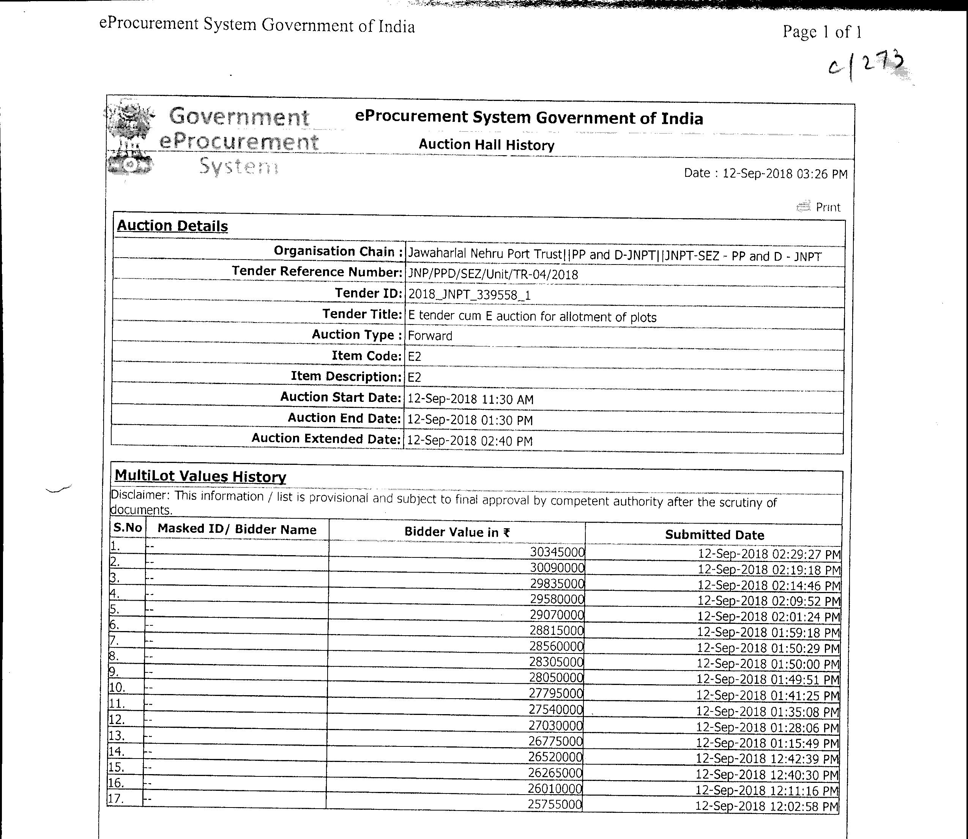
In any plot if multiple bidders are participating in auction the values of the multilot auction are seen as per this slide at the end of auction and the final highest bidder is the successful bidder, the names of the bidder can be masked as per user department selection while creating auction

Slide 11
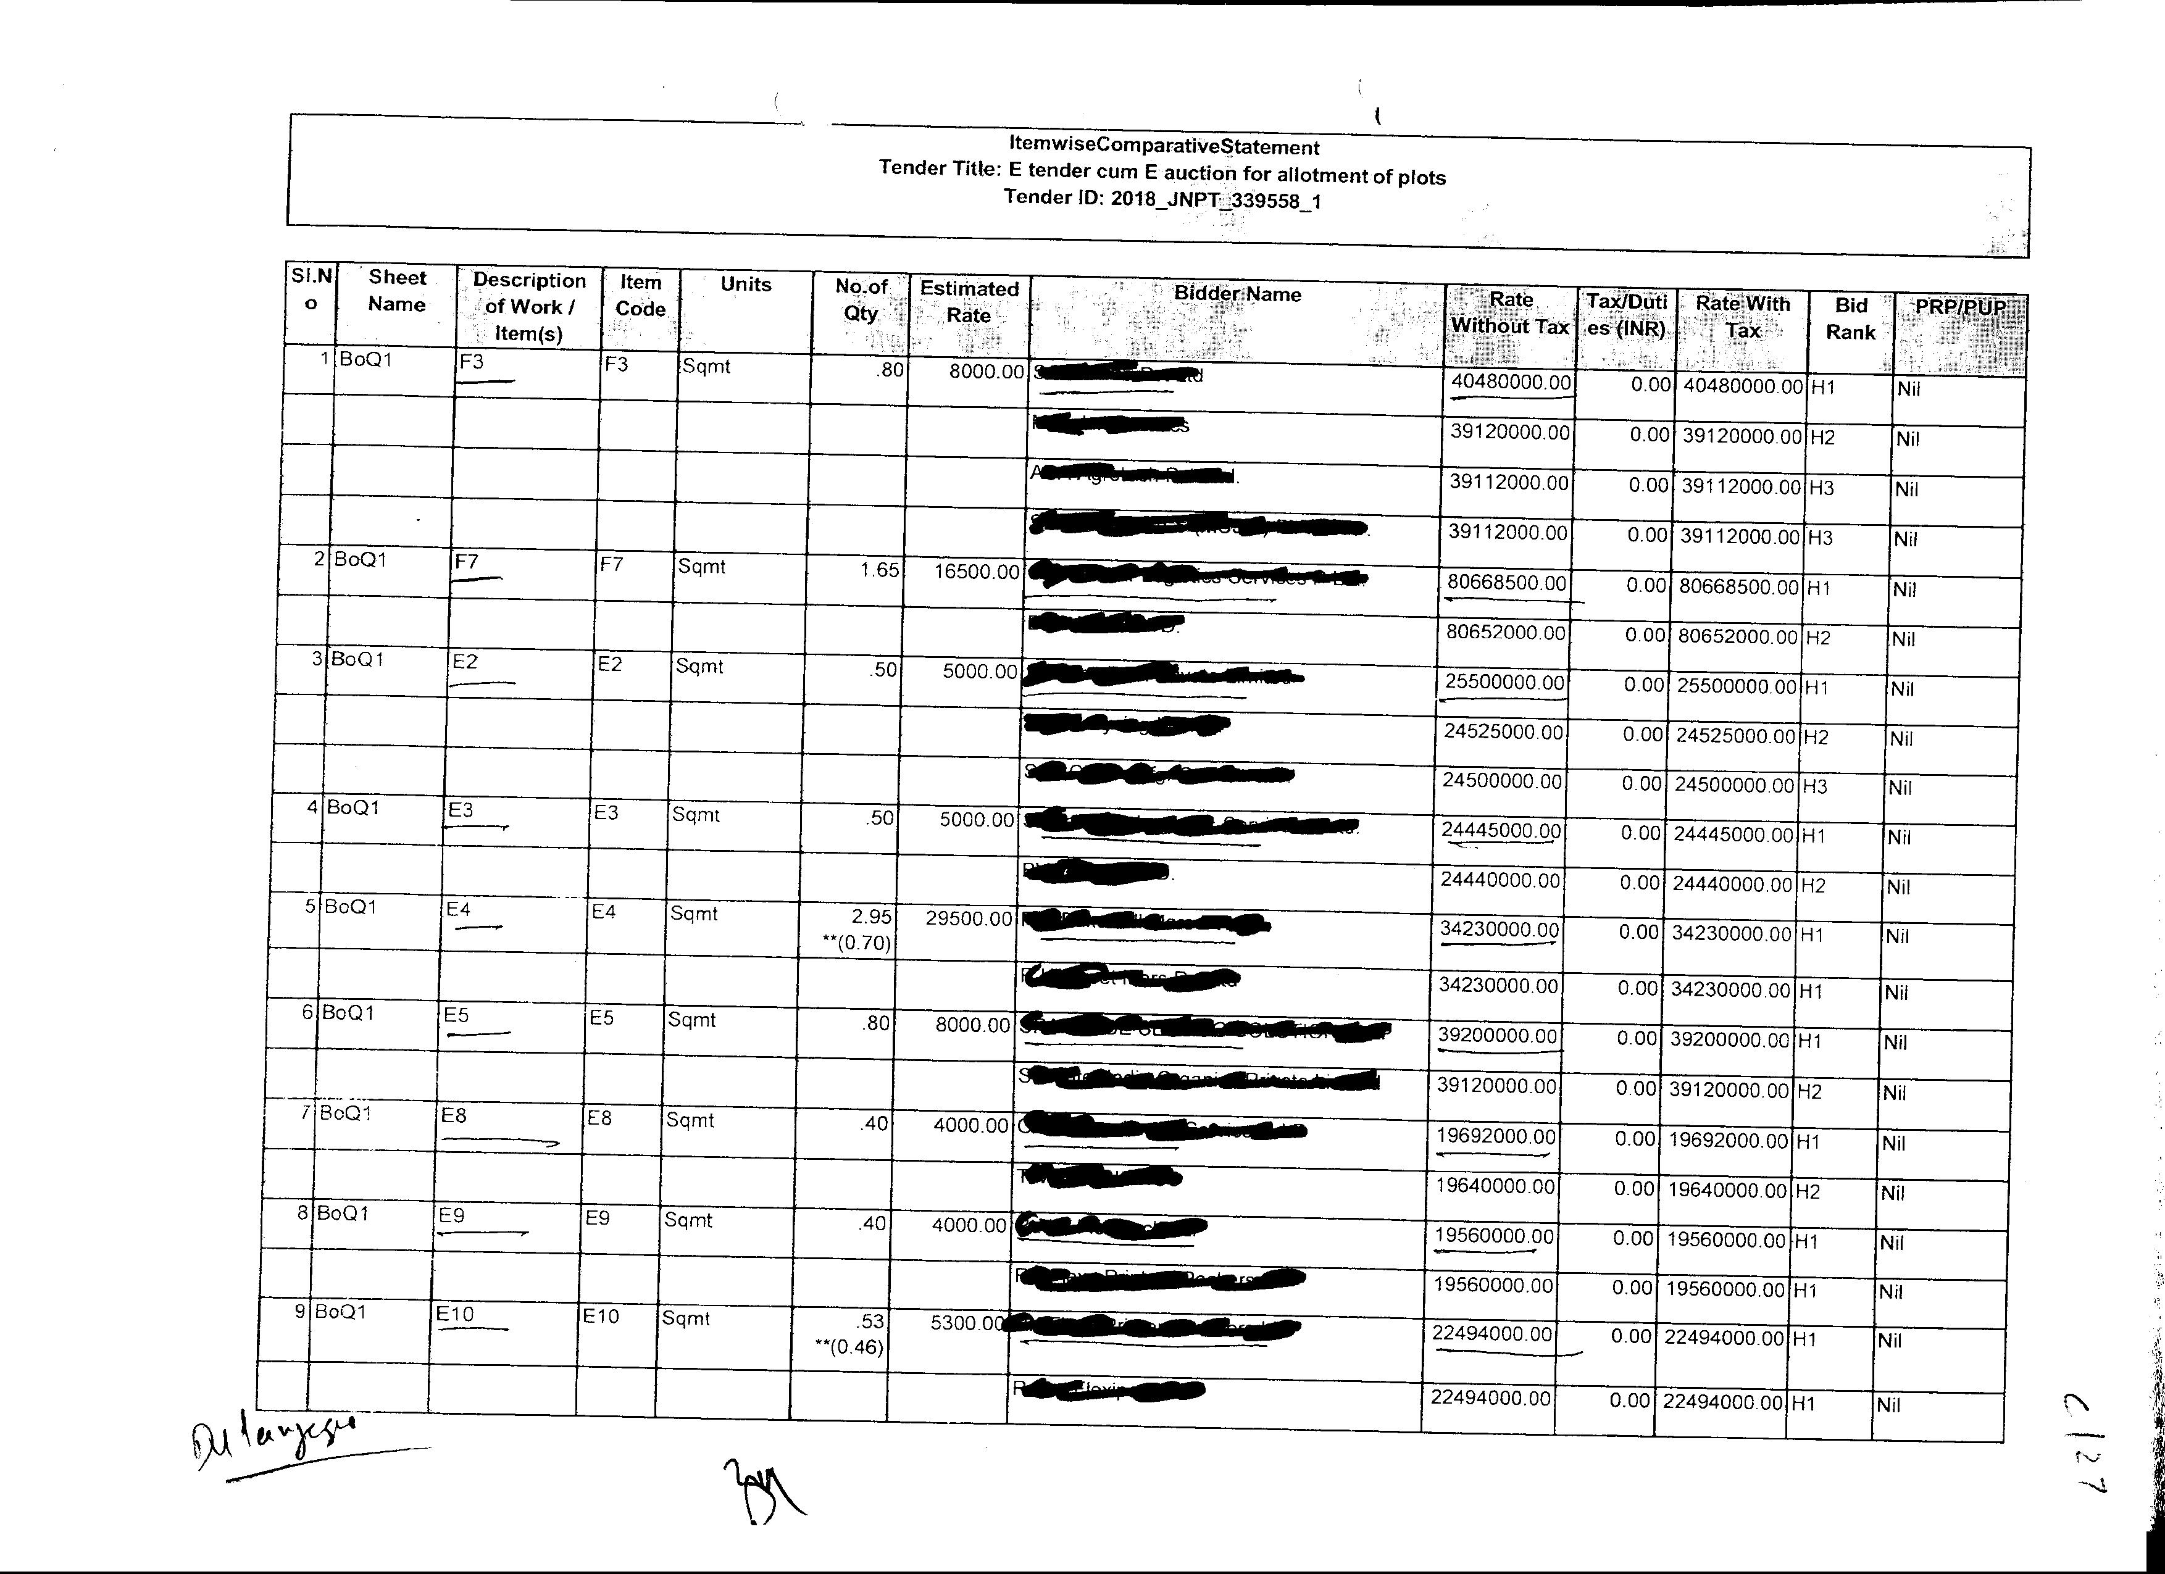
Here the sample of the final BOQ received after e-auction process for 9 plots where auction quotes received are shown where the details of the rates of Financial bid are shown

Slide 12
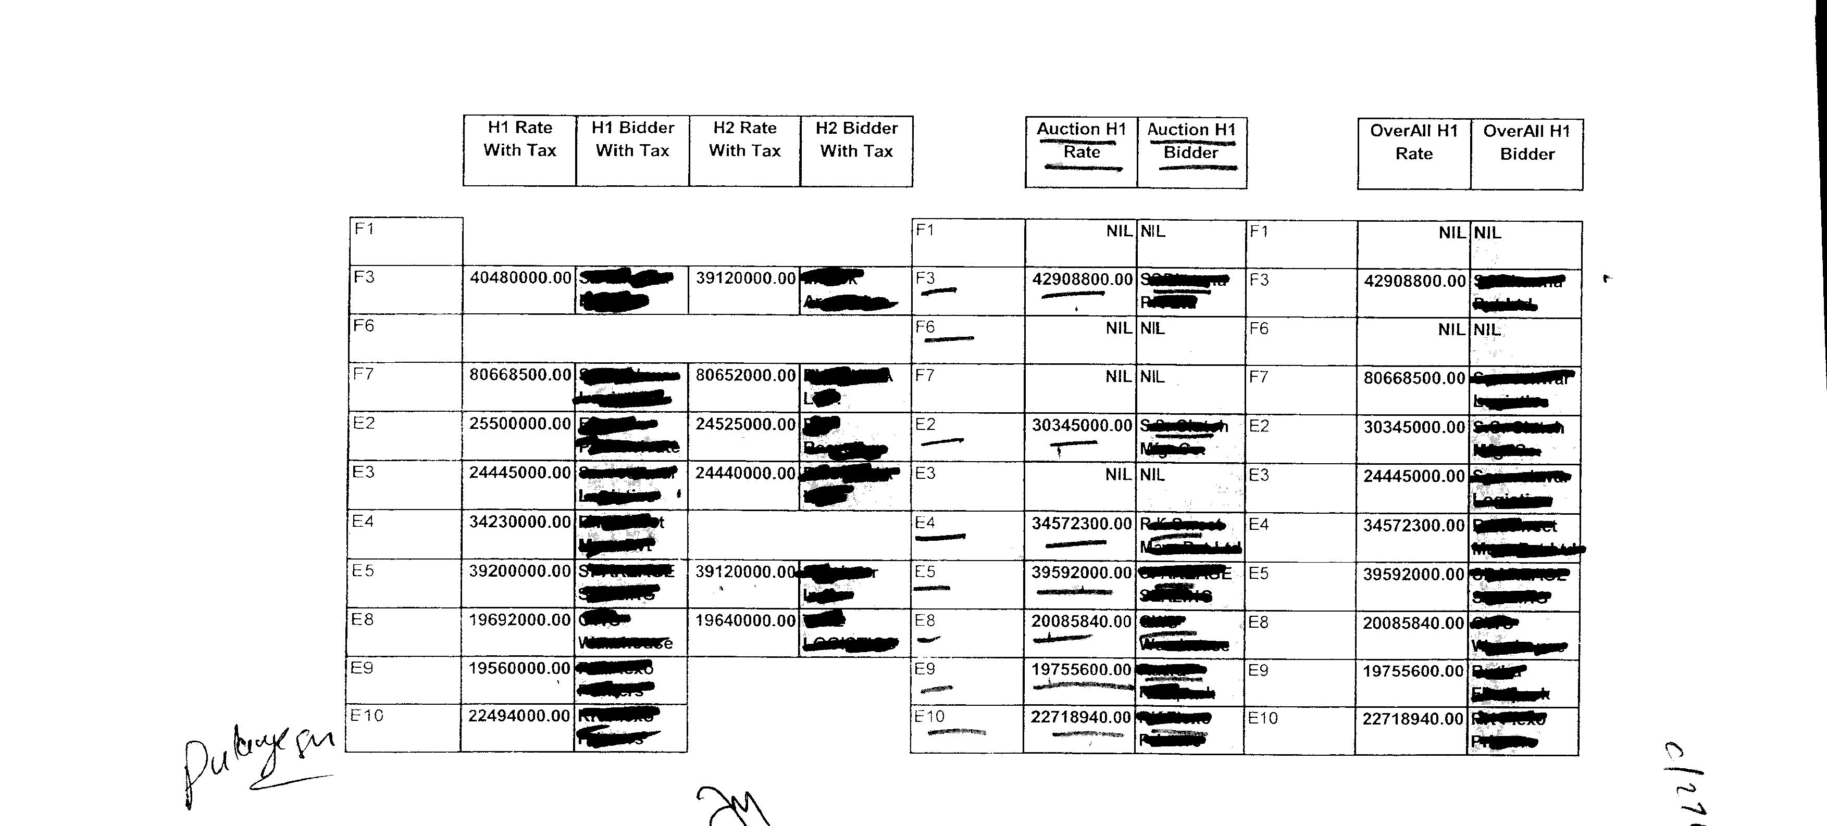
The final data of the 9 plots auctioned with highest bid value in right most column, (names masked for secrecy, 2 plots no response and to be retendered)

Slide 13
Multi Currency e-procurement- For Scanners by IPA
A standard price bid schedule format has been provided with the tender document. The Prices should be quoted in a spread sheet file (.xls format) available in e-procurement Portal only. The rates offered details have to be entered separately in a spread sheet file (xls format Price bid) in the space allotted and should be updated as BOQ.xls file for each tender after the financial bid. The BOQ file, if found modified by the bidder, his bid will be rejected.
The item rate is to be indicated against each item of work/s.
The rate will be applicable to the item against which the rate is quoted.
The Bidders can select currency/ies ( i.e USD, EURO) for supply items, however for CAMC the bidders have to quote in Indian Rupees (INR)
The figures entered in the column notified as Rates will have automatic conversion to words in next column and thereafter the amount is calculated with multiplication of rate and quantity. This would be carried forward until end of BOQ.
Total amount is calculated based on the final evaluation as stated in Sr. No 1.52 Bid evaluation.
Bidders need not insert anything other than rate in figures and name of the firm.
For evaluation purpose the uploaded offer documents will be treated as authentic and final. No hard copy shall be submitted for reference purpose. The price bid submitted through e-procurement mode only will be taken up for the purpose for evaluation. Any indication of ‘Quoted price’ in the online technical bid documents shall lead to rejection of the bid outright.

Slide 14
Validate
Print
Help
Item Wise BoQ
Tender Inviting Authority: Indian Ports Association
Name of Work: Supply, Site Preparation, Installation & Commissioning of Drive- through Container Scanner System (Road)
Contract No: IPA/GAD/Containers Scanner/2018
Bidder Name :
PRICE SCHEDULE (This BOQ template must not be modified/replaced by the bidder and the same should be uploaded after filling the relevent columns, else the bidder is liable to be rejected for this tender. Bidders are allowed to enter the Bidder Name and Values only)
Sl. No. | Item Description | Item Code / Make | Quantity | Units | Currency Convertion against each Item | Quoted Currency in INR / Other Currency | BASIC RATE In Figures (To be entered by the Bidder) | GST In % Only | TOTAL AMOUNT, based on column L value | TOTAL TAXES as INR | TOTAL AMOUNT In Words for column BA
1 | 2 | 3 | 4 | 5 | 11 | 12 | 13 | 15 | 53 | 54 | 55
1 | I. KOLKATTA PORT TRUST
2 | PART I- COST OF SCANNER SYSTEM
3 | Cost of Drive-through Container Scanner System (including insurance and freight) (Rs. or any freely convertible currency) (indicate the currency) | item1 | 1.00 | Nos | Full Conversion | USD |  |  | 0.00 | 0.00 | USD Zero Only
4 | Any other charges up to the stage of landing/delivery (to be specified), if any, (Rs. or any freely convertible currency) (indicate the currency) | item2 | 1.00 | Nos | Full Conversion | USD |  |  | 0.00 | 0.00 | USD Zero Only
5 | Total landed cost (Rs. or any freely convertible currency) (indicate the currency) | item3 | 1.00 | Nos | Full Conversion | USD |  |  | 0.00 | 0.00 | USD Zero Only
6 | Installation and Commissioning charges, if any (Rs.) | item4 | 1.00 | Nos | Full Conversion | INR |  |  | 0.00 | 0.00 | INR Zero Only
7 | Customs Duty (Rs.) | item5 | 1.00 | Nos | Full Conversion | INR |  |  | 0.00 | 0.00 | INR Zero Only
8 | Excise Duty (Rs.) | item6 | 1.00 | Nos | Full Conversion | INR |  |  | 0.00 | 0.00 | INR Zero Only
9 | Service Tax / Edu. Cess, if any, on installation and commissioning charges (Rs.) | item7 | 1.00 | Nos | Full Conversion | INR |  |  | 0.00 | 0.00 | INR Zero Only
10 | Agent’s commission, if any, (Rs.) | item8 | 1.00 | Nos | Full Conversion | INR |  |  | 0.00 | 0.00 | INR Zero Only
11 | Any other cost/ charges (to be specified), if any, (Rs.) | item9 | 1.00 | Nos | Full Conversion | INR |  |  | 0.00 | 0.00 | INR Zero Only
12 | Any other taxes, levies(to be specified), if any, (Rs.) | item10 | 1.00 | Nos | Full Conversion | INR |  |  | 0.00 | 0.00 | INR Zero Only
13 | Cost of construction of Drive-through container scanner (Road) facility including site preparation (Rs.) | item11 | 1.00 | Nos | Full Conversion | INR |  | 0.00% | 0.00 | 0.00 | INR Zero Only
14 | PART II- CAMC CHARGES:
15 | Annual Maintenance Please refer technical specification. 1st year (post guarantee period) | item12 | 1.00 | Nos | Full Conversion | INR |  | 6.00% | 0.00 | 0.00 | INR Zero Only
16 | 2nd year (post guarantee period) | item13 | 1.00 | Nos | Full Conversion | INR |  | 0.00% | 0.00 | 0.00 | INR Zero Only
17 | 3rd year (post guarantee period) | item14 | 1.00 | Nos | Full Conversion | INR |  | 0.00% | 0.00 | 0.00 | INR Zero Only
18 | 4th year (post guarantee period) | item15 | 1.00 | Nos | Full Conversion | INR |  | 0.00% | 0.00 | 0.00 | INR Zero Only
19 | 5th year (post guarantee period) | item16 | 1.00 | Nos | Full Conversion | INR |  | 0.00% | 0.00 | 0.00 | INR Zero Only
20 | 6th year (post guarantee period) | item17 | 1.00 | Nos | Full Conversion | INR |  | 0.00% | 0.00 | 0.00 | INR Zero Only
21 | 7th year (post guarantee period) | item18 | 1.00 | Nos | Full Conversion | INR |  | 0.00% | 0.00 | 0.00 | INR Zero Only
22 | 8th year (post guarantee period) | item19 | 1.00 | Nos | Full Conversion | INR |  | 0.00% | 0.00 | 0.00 | INR Zero Only
Total in Figures Quoted Rate in Words |  |  |  |  |  |  |  |  | 0.00 | 0.00 | Zero Only
 |  | Zero Only

