Slide 1

IMPLEMENTATION OF e-PROCUREMENT IN CSIR
R.K. RAO
Senior Controller of Stores and Purchase
CSIR Hqrs

Slide 2
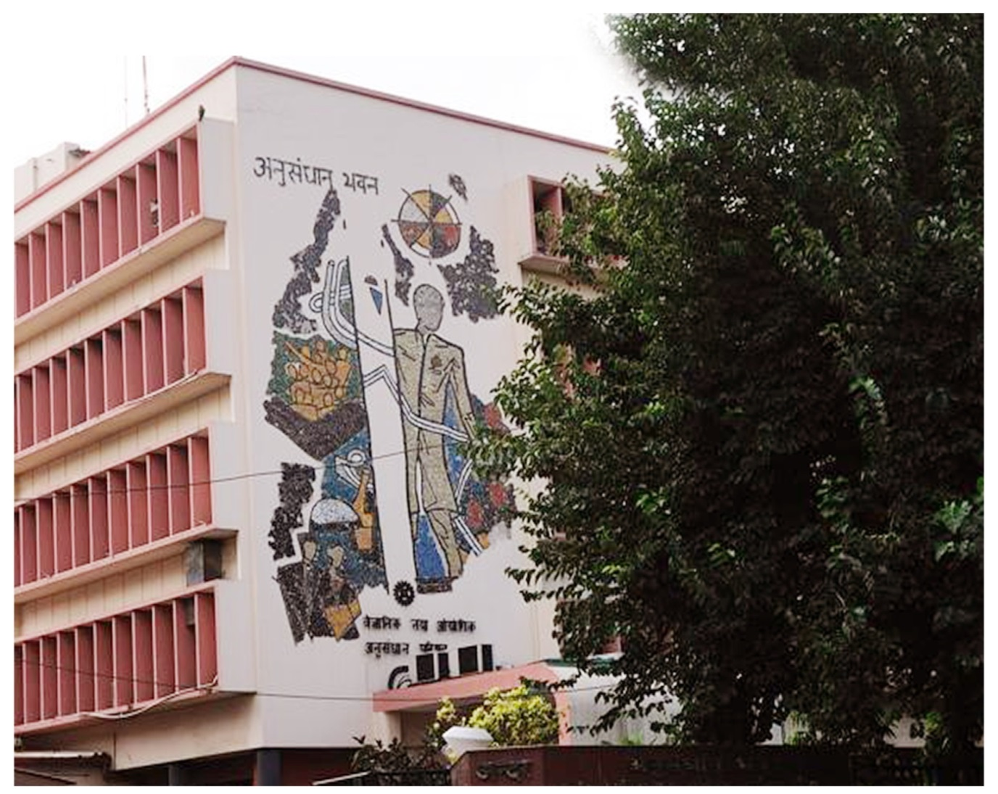

Slide 3
Council of Scientific & Industrial Research (CSIR) is known for its cutting edge R&D knowledgebase in diverse S&T areas and today it is a contemporary R & D organization having pan-India presence, CSIR has a dynamic network of 37 national laboratories, 39 outreach centres, 3 Innovation Complexes and 5 units.

Slide 4
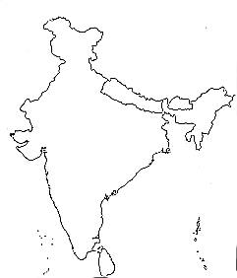
CSIR – Pan India Presence
37 Laboratories
5 Units
IIIM
NPL, CRRI, IGIB, NISCAIR,
NISTADS, CSIR HQ
IMT
CSIO
IHBT
IIP
CDRI, CIMAP, IITR, NBRI
CEERI
CBRI
NEIST
CIMFR
AMPRI
NML
CMERI
IICB
CGCRI
CSMCRI
NEERI
IMMT
Physical Sciences
Chemical Sciences
Biological Sciences
Engineering Sciences
Information Sciences
NCL
NIO
CCMB
IICT
NGRI
4 PI
NAL
CFTRI
SERC
CLRI
CECRI
NIIST

Slide 5
CSIR covers a wide spectrum of science and technology – from radio and space physics, oceanography, earth sciences, geophysics, chemicals, drugs, genomics, biotechnology and nanotechnology to mining, materials, aeronautics, instrumentation, environmental engineering and information technology.

Slide 6
CSIR provides significant technological interventions in many areas which include environment, health, drinking water, food, housing, energy, specialty chemicals & petrochemicals, glass & ceramics, medicinal plants & plants of economic value, leather, mining, metals & minerals, machinery & instrumentation, strategic sectors including aerospace etc. In doing so, CSIR partners with Industry in a significant manner.

Slide 7
CHALLENGES FACED
Taking on board all stakeholders for uniform implementation of e procurement on PAN CSIR basis.
Identifying stream wise key personnel for undergoing training in each of the procuring entity of CSIR to act as train the trainers.
Assignment of roles.
Imparting training.

Slide 8
NIC formally engaged by CSIR on 16th Mar 2017.
An e-procurement cell was setup in CSIR Headquarters during Apr 2017 to monitor progress of implementation.
All CSIR labs/Instts. Informed of the need to migrate to e-proc portal from conventional manual process on 17th Mar 2017.

Slide 9
Pan India organizational structure created by NIC and mapping of the roles and sub-Nodal officers done by CSIR.
NIC imparted training to around 350 officials as train the trainer during Apr/May 2017 across the country on 6 occasions.
Instructions given to all CSIR labs to operate on the Demo portal to familiarise on end to end basis before migrating to the e-procurement portal.
Finally CSIR made e-procurement mandatory in CSIR w.e.f 7th Nov 2017.

Slide 10
Bidders enrolled in e-tenders portal
From 1-Jan-2018 to 31 Mar 2018 – 2500.
From1-Apr-2018to 31-Dec-2018- 7500 .
Total No. of bidders enrolled- 21800.

Slide 11
More than 700 user accounts have been created in e-tender portal
More than 500 user account are created in e-publish portal.
Total numbers and values of tenders published
Period Nos Value(Rs)
(only works)
From 1st Dec 2017 to 31th Mar 2018 1995 57Cr
From 1st Apr 2018 to 31th Dec 2018 4125 179Cr

Slide 12
No of hits on the portal by vendors for searching CSIR tenders from 1-Apr-2018 to 31-Dec-2018
50,000 appx

Slide 13
3 Refresher trainings held during Oct-Nov 2018 for freshers and others stake-holders.
CSIR is of the opinion that full potential of the portal is not being explored by the stake-holders.
Meeting scheduled on 28th Jan 2019 between CSIR and NIC to understand the new features of the portal like Make in India , Procurement from MSEs, 2 stage bidding, NDA etc. so that all the stake-holders are sensitized and take advantage.

Slide 14
Benefits accrued
The No. of complaints received from bidders have reduced.
Competition improved significantly.
The lead time for placement of orders reduced.
Procurement costs have reduced.
Compliance to rules, procedures increased thereby infusing confidence.
Both buyers and bidders have become more disciplined.

Slide 15
THANK YOU

